Slide 1
The Tourism Destination/Area Life Cycle! («TALC»)
Discovery
Local control
Institutionalism
Stagnation,
Rejuvenation or decline
Rejuvenation
Stagnation
Consolidation
Number of visitors or other KPI
Development
Involvement
Decline
Exploration
Time
Adapted from source: WTO, A practical Guide

Slide 2
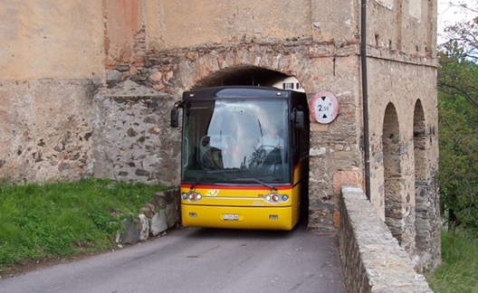
Tourism Planning
Effective, competent tourism planning:
  Basis for Tourism Master Plan / Strategy
  Help ensure the location avoids decline by prolonging its maturity phase
  Helps to reach the goals
  Helps ensure fair and sustainable policies are enacted
  Helps to mitigate negative impacts of tourism (e.g. «overtourism» or «undertourism»

Slide 3
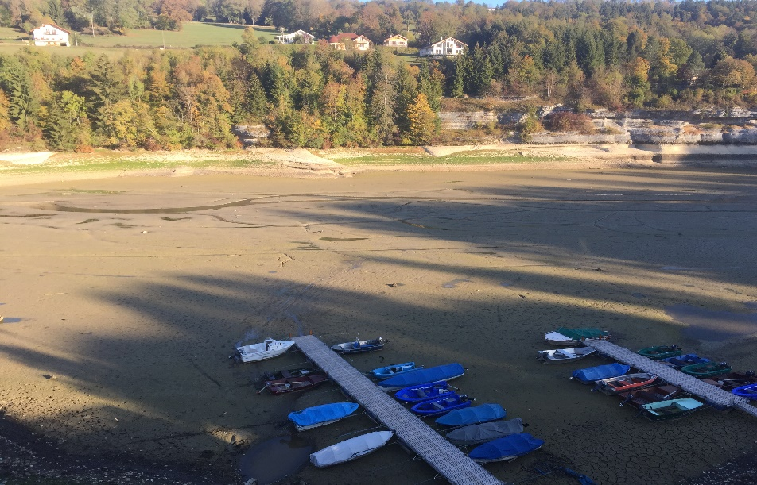
Principles for Planning
  Selected goals for tourism planning:
    Improved economy and business success
    Enhanced visitor satisfaction
    Developing infrastructures and providing recreation facilities for visitors (and residents)
    Sustainable resource use
    Community and area integration
    And many more
Source: Gunn and Turgut in Walker and Walker, 2011

Slide 4
Fragmented Planning within the Destinations
«Political» Life Cycle
Tourism Life Cycle
Development
Lack of harmonisation
Merge of Strategies
Time
Permanent & coordinated planning to avoid any kind of unwished impacts and to guarantee sustainable development.

